Slide 1


Slide 2



Slide 3
Instructor : Hany Al-saied

Slide 4
Team Leader : Yousef Mosad Team Members: 1- yahya Khaled 2- Silvia Hany 3- Dina Mahmoud 4-Gehaad Magdi

Slide 5
Today, we will discuss a crucial topic in the world of technology and financial management—Oracle Systems. These systems are among the most powerful solutions for managing data and business operations in organizations. Our focus will be on Oracle ERP, a comprehensive enterprise resource planning system, along with Oracle Fixed Assets, a key module for efficient asset management.
🔹 Oracle is a global leader in providing advanced database solutions and cloud services, helping businesses enhance performance and analyze data more intelligently. 🔹 Oracle ERP (Enterprise Resource Planning) is an integrated system for managing various financial and administrative operations, such as accounting, inventory management, supply chains, and human resources. It enhances efficiency and supports informed decision-making. 🔹 Oracle Fixed Assets is a critical module within Oracle ERP that helps organizations manage and track fixed assets like equipment and properties. It improves financial accuracy, automates depreciation calculations, and simplifies financial reporting.
In this presentation, we will explore how these systems enable businesses to achieve greater financial and operational efficiency. Let’s get started!

Slide 6
Gehaad Magdi
2. Setup Fixed Assets:
Flex Field Assets|
Category
Locations
Asset Key
System Control
Fiscal Years
Calendar
Prorate Convention
Book Control
Assets Categories
Create New:
Fixed Assets Responsibility
Profile Options

Slide 7
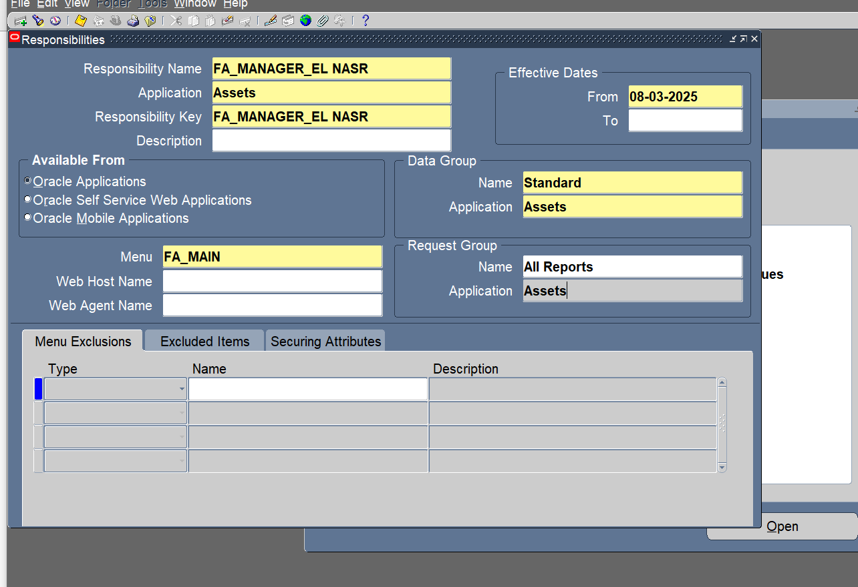
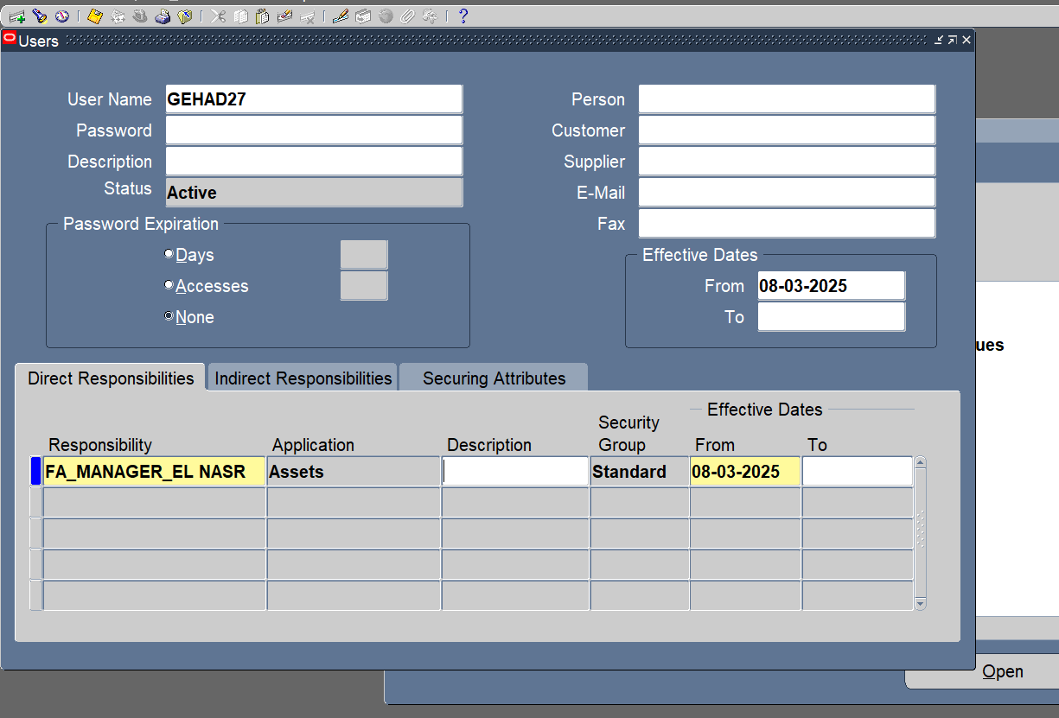
Create New Fixed Assets Responsibility:
System Administrator > Security > Responsibility > Define
Security > User > Define

Slide 8
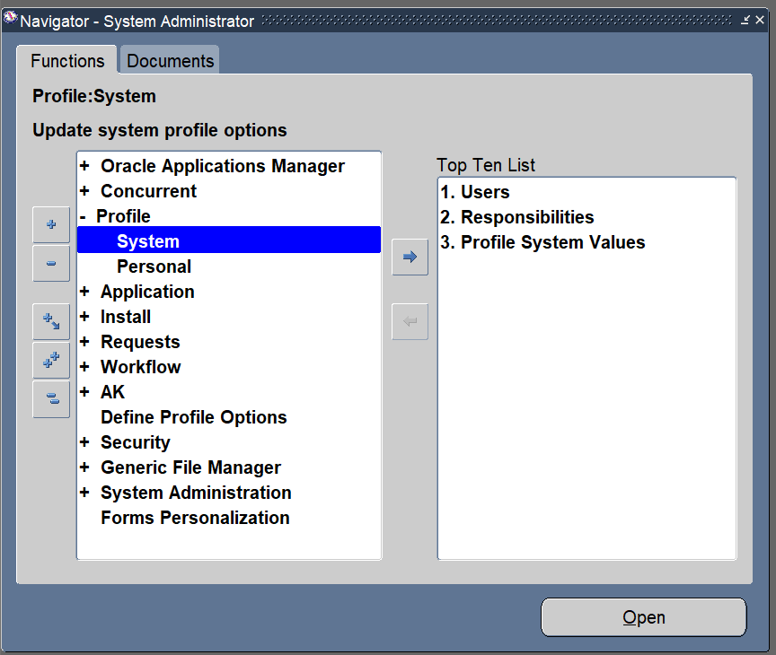
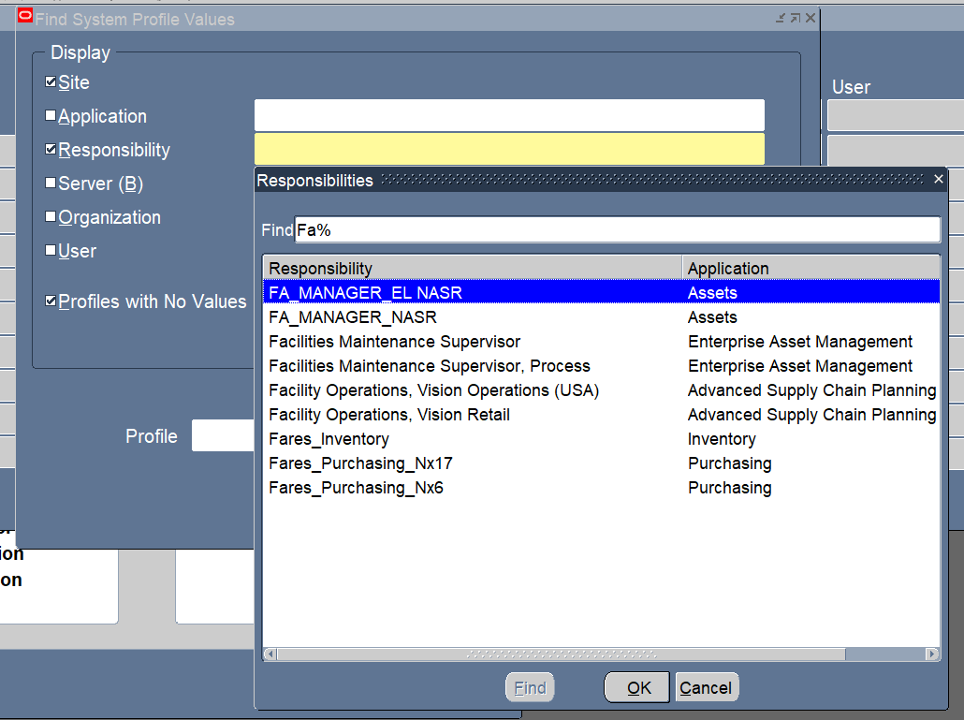
Create New Profile Options:
System Administrator > Profile > System

Slide 9
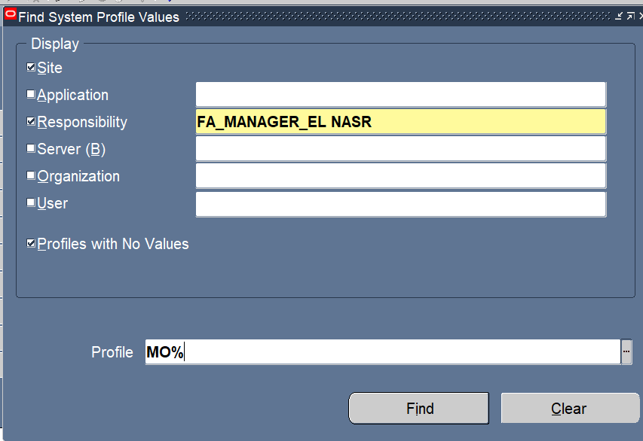
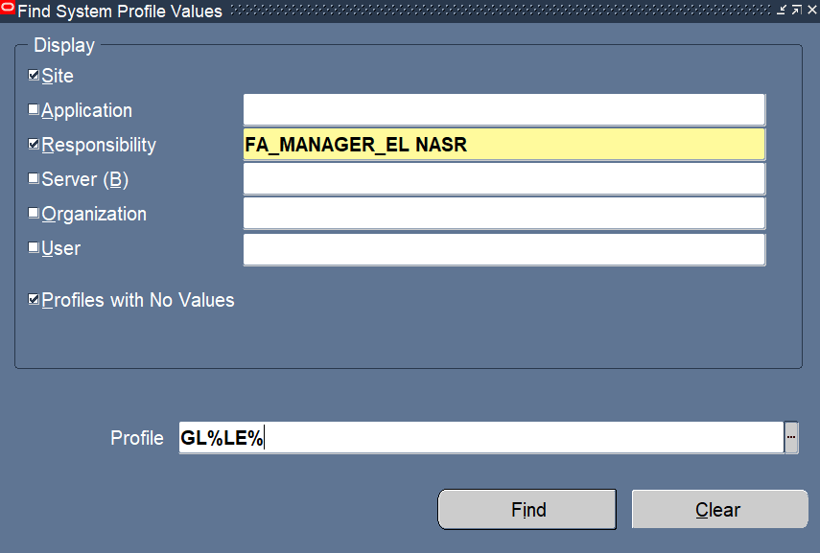

Slide 10
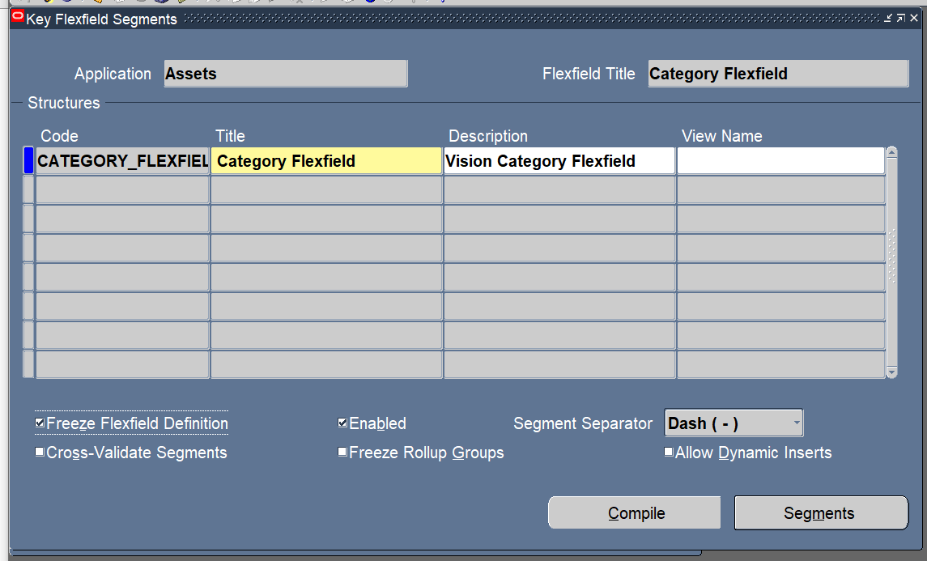
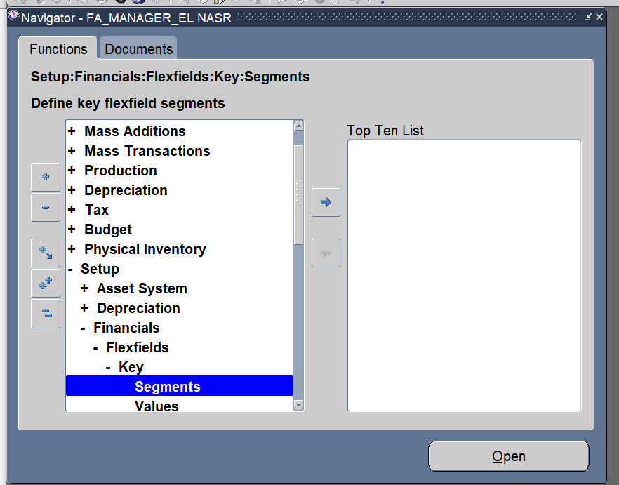
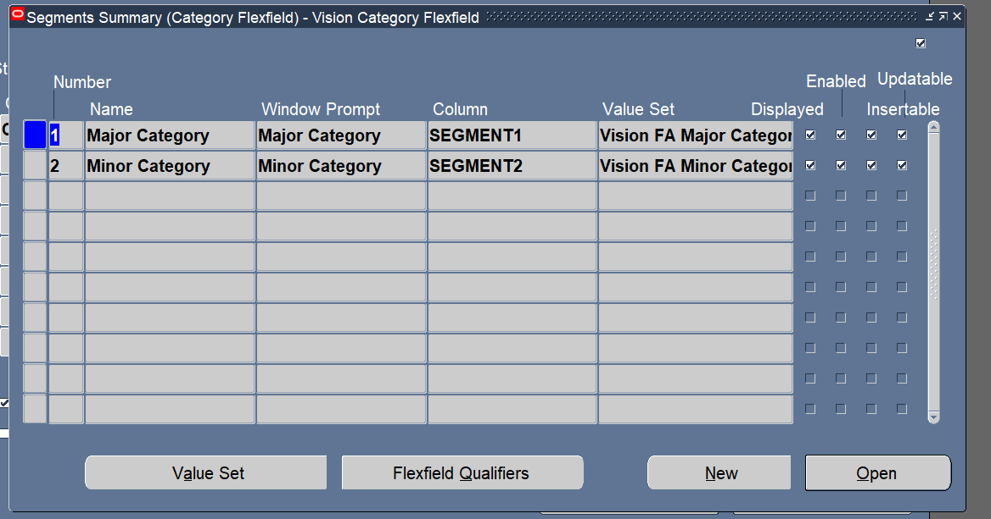
Setup Flex Field Assets|
Category
Setup > Financial > Flex field > Segments

Slide 11
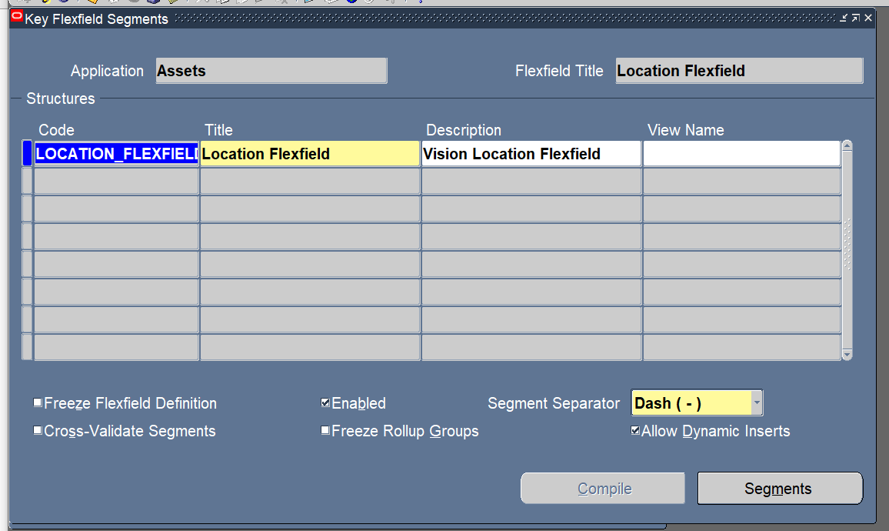
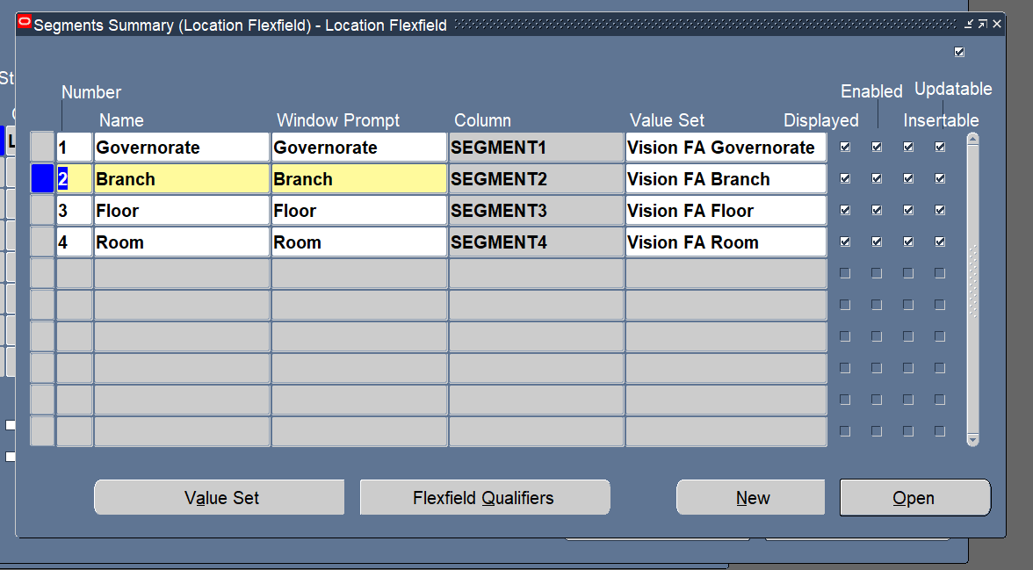
Locations

Slide 12
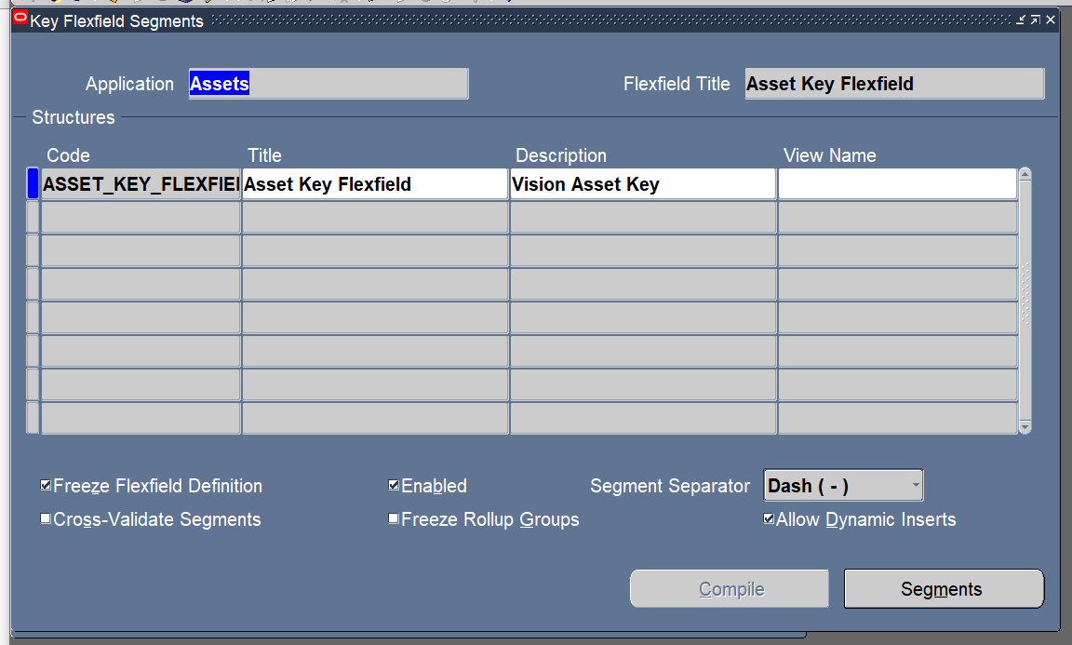
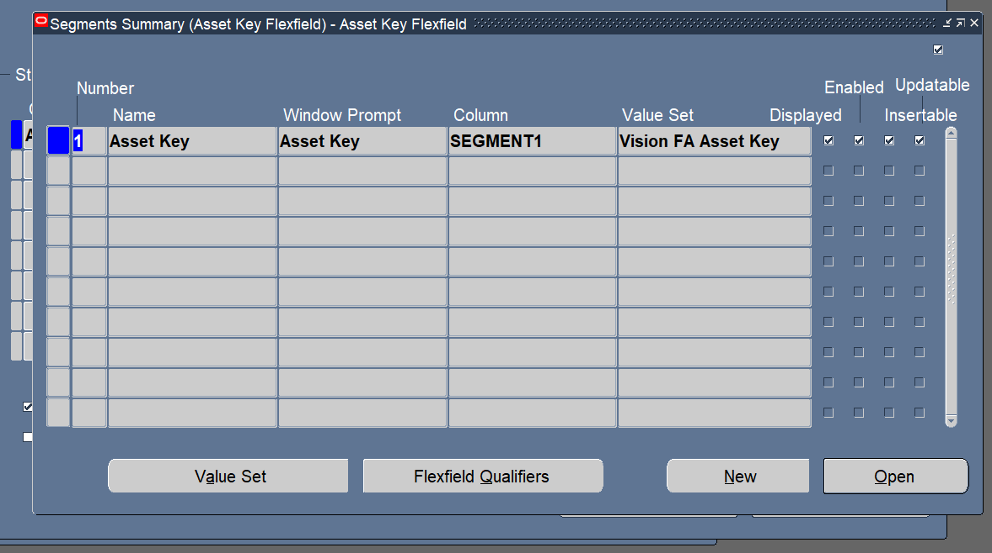
Asset Key

Slide 13
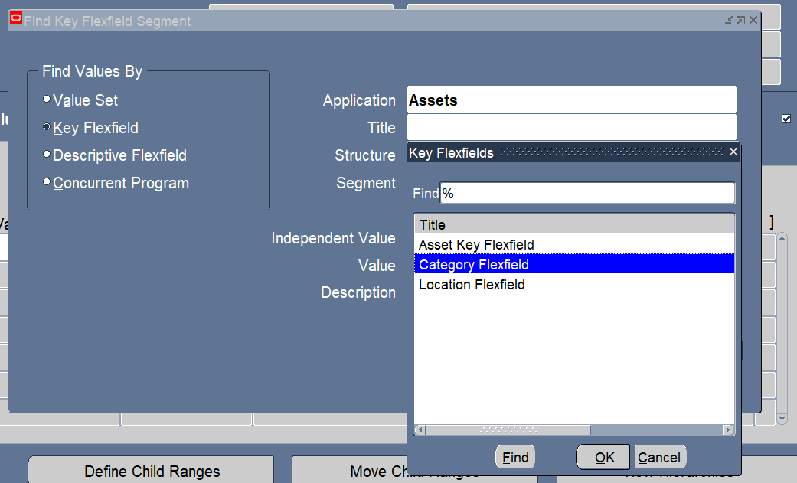
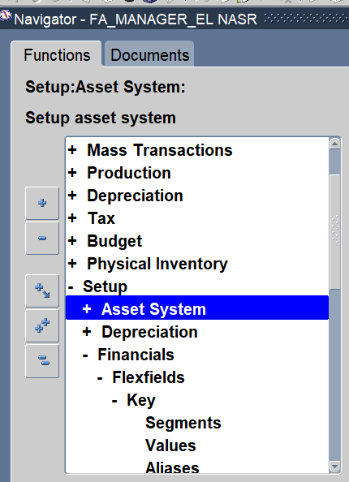
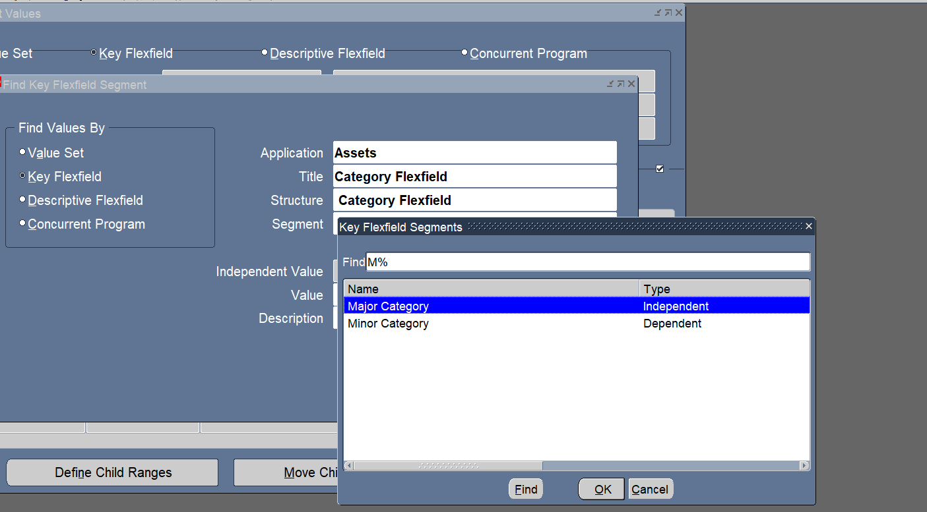
Value Set
Financial > Flex field > key > value

Slide 14
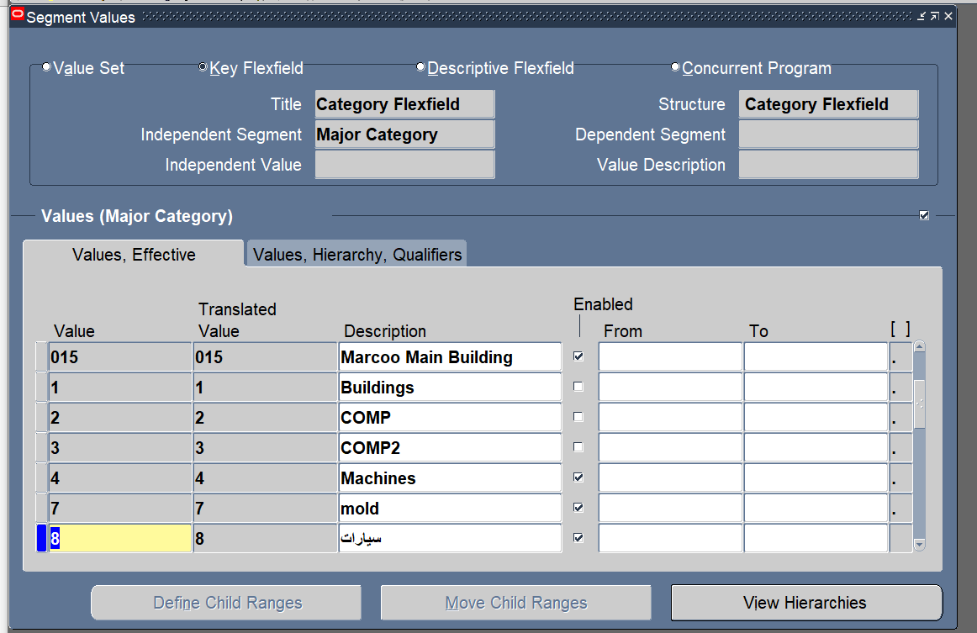
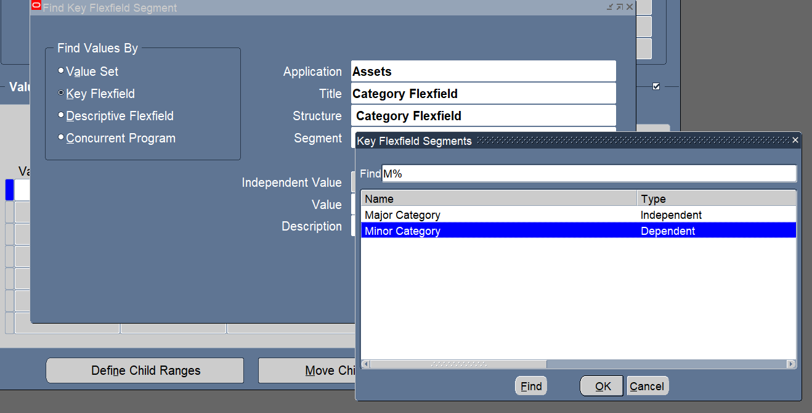

Slide 15
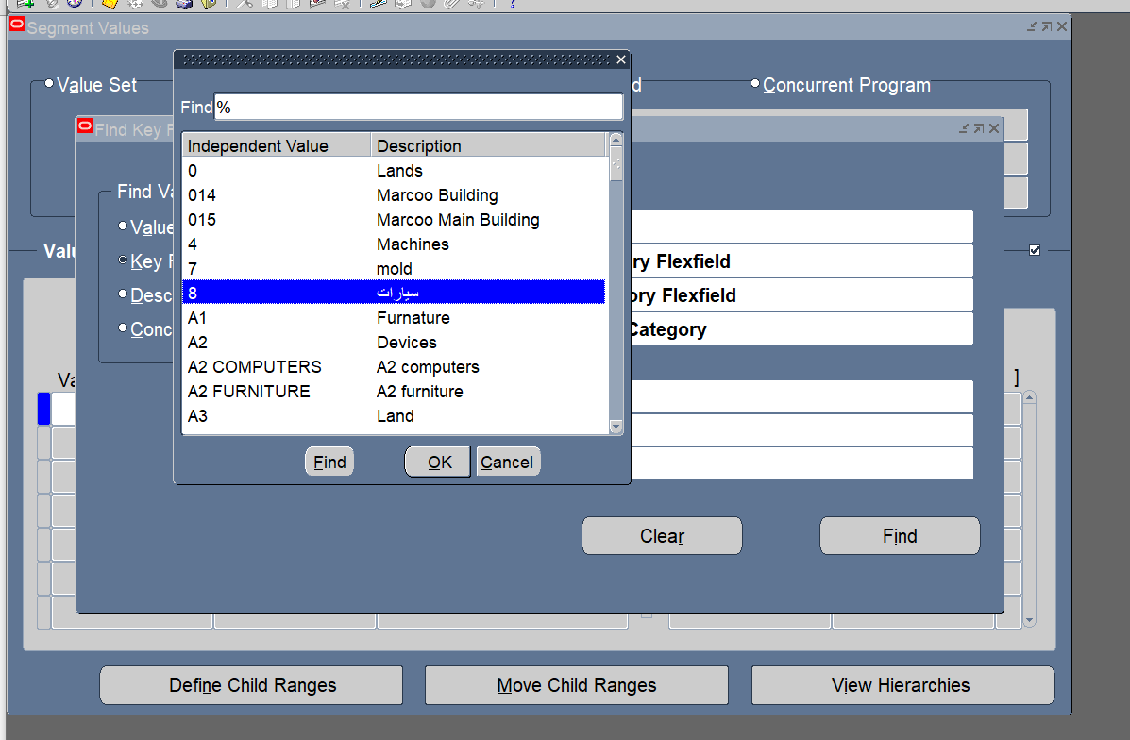
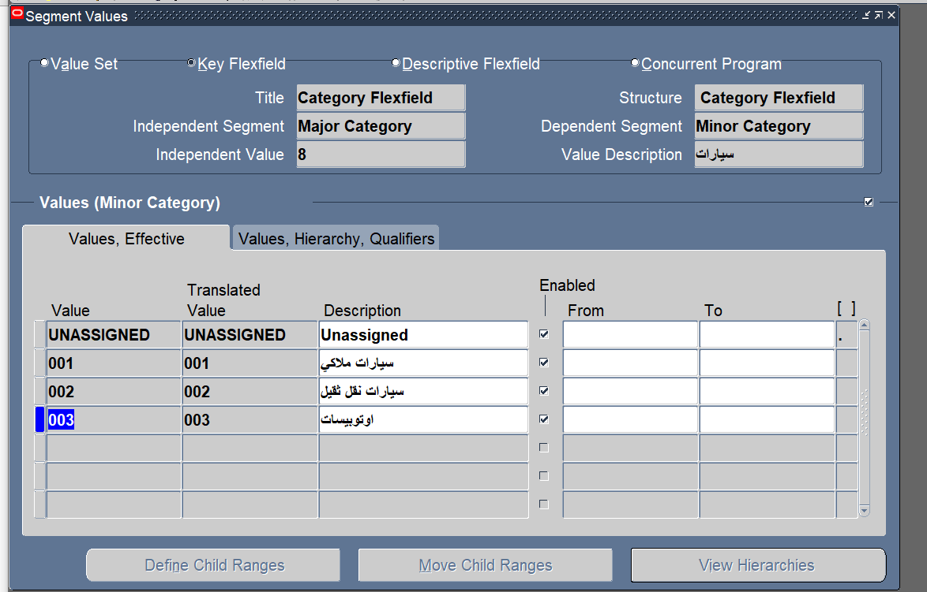

Slide 16
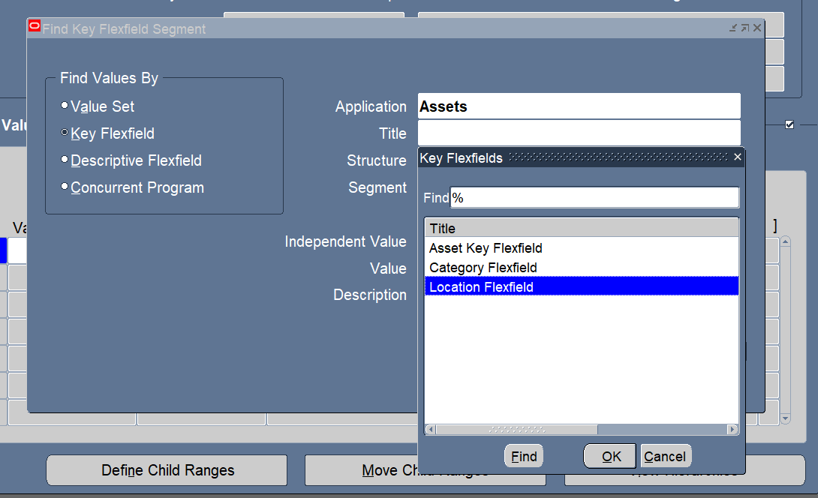
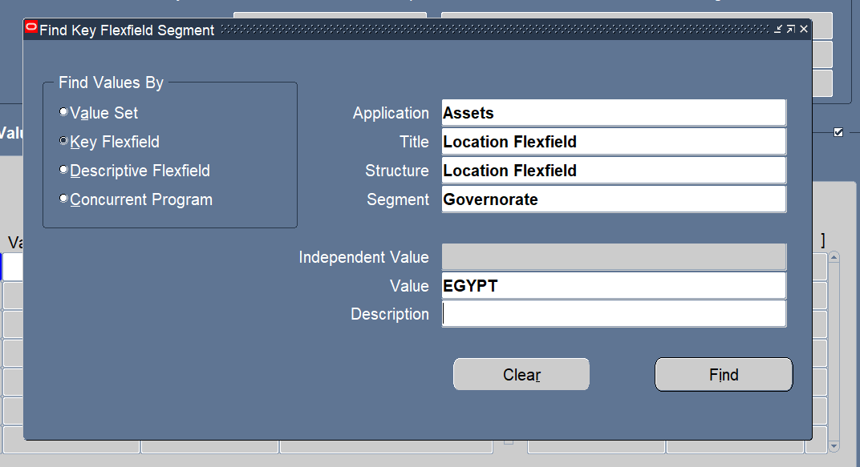
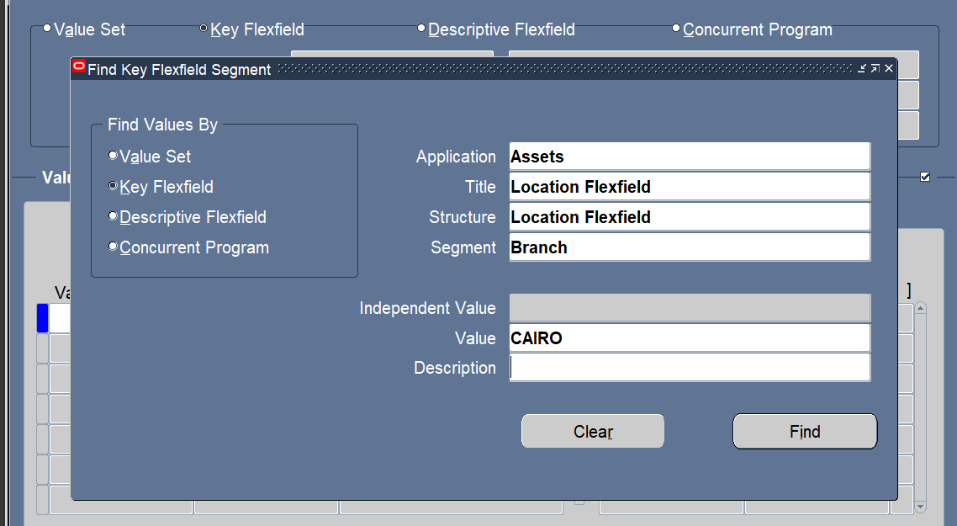
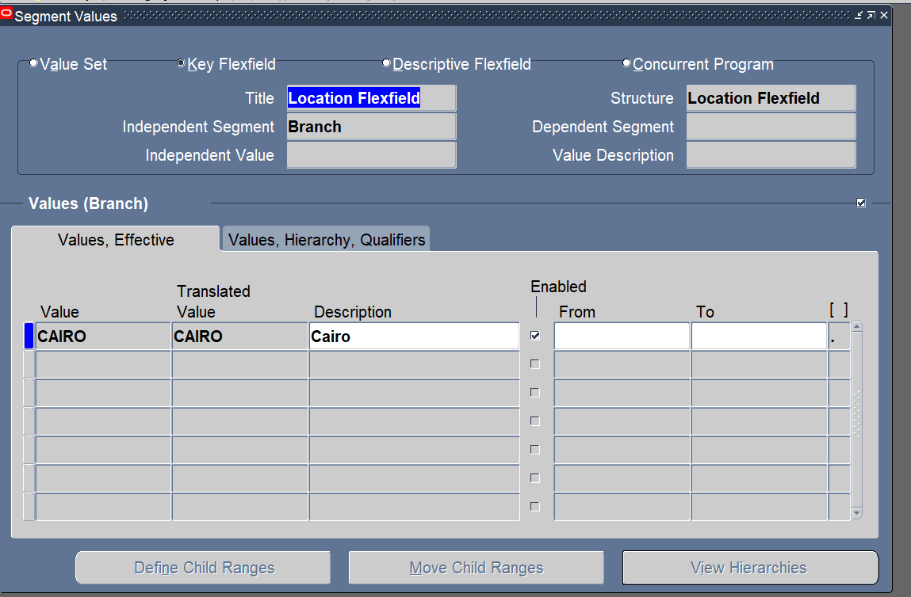

Slide 17
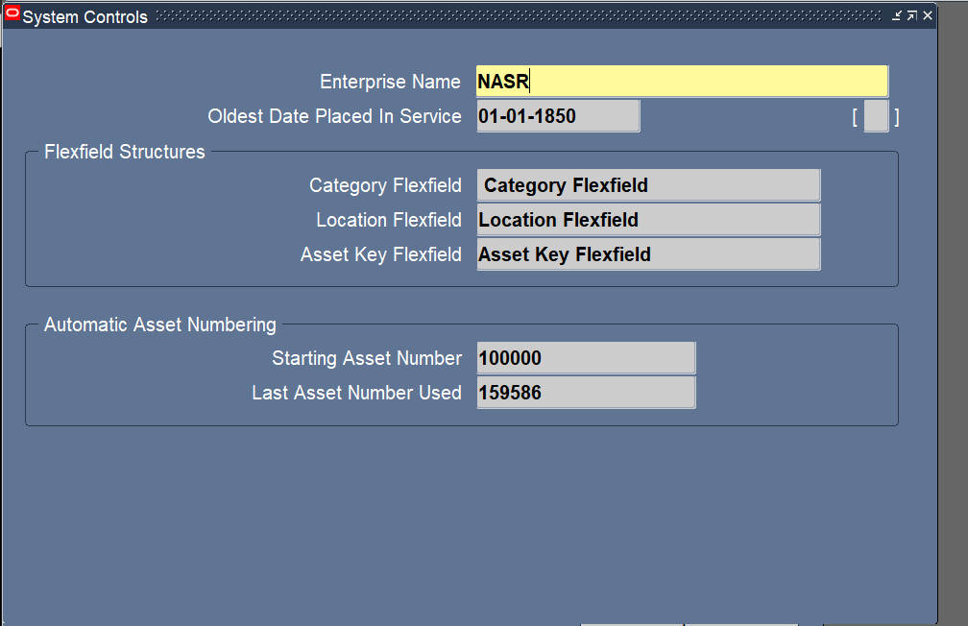
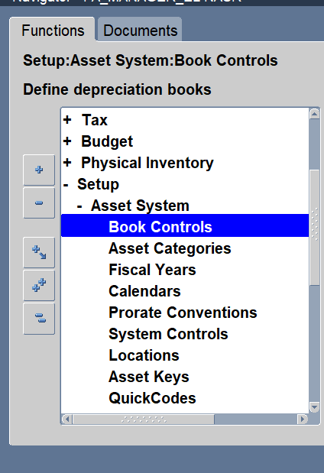
Setup System Control

Slide 18
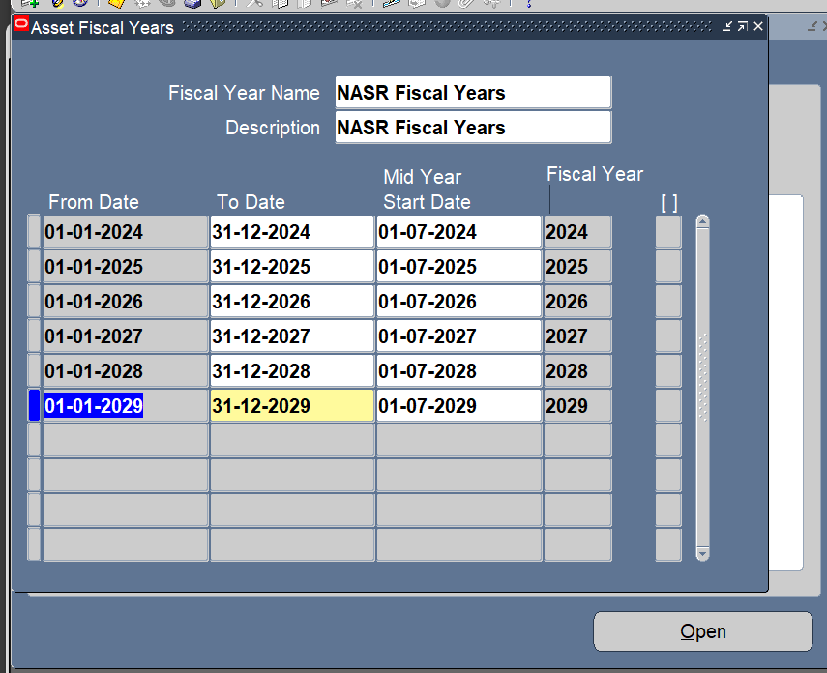
Setup Fiscal Years

Slide 19
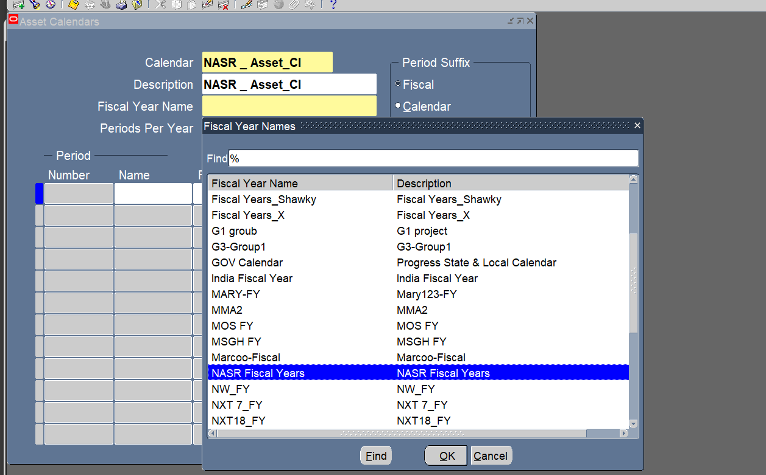
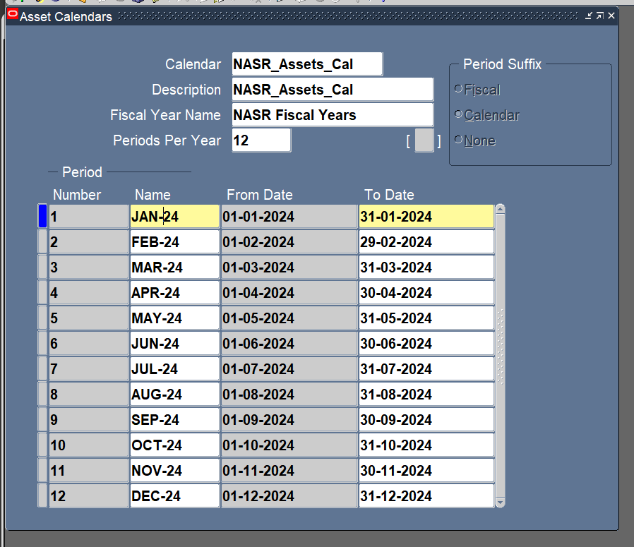
Setup Calendar

Slide 20
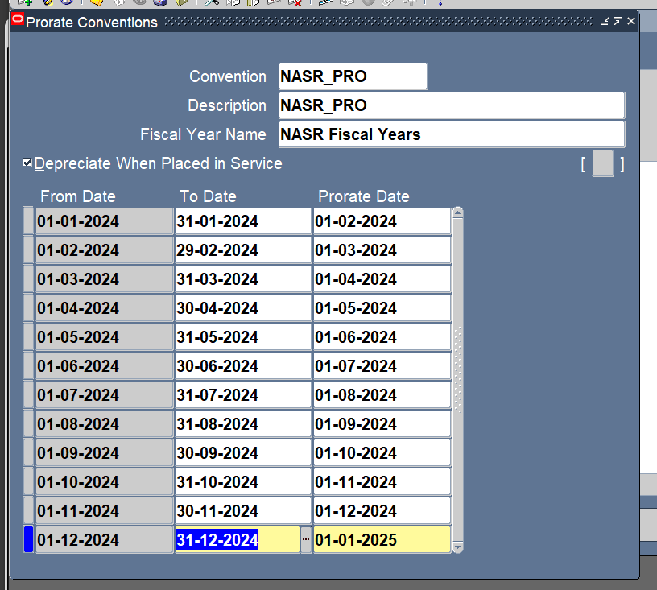
Setup Prorate Convention

Slide 21
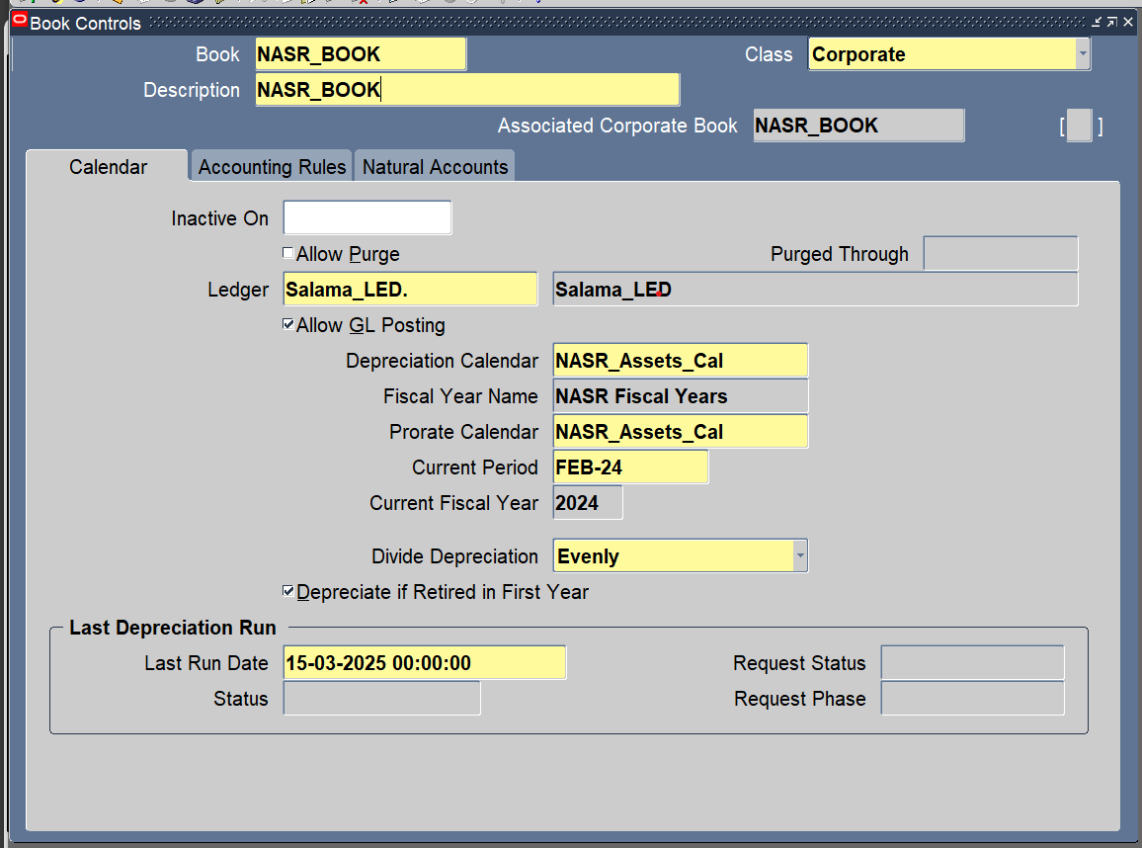
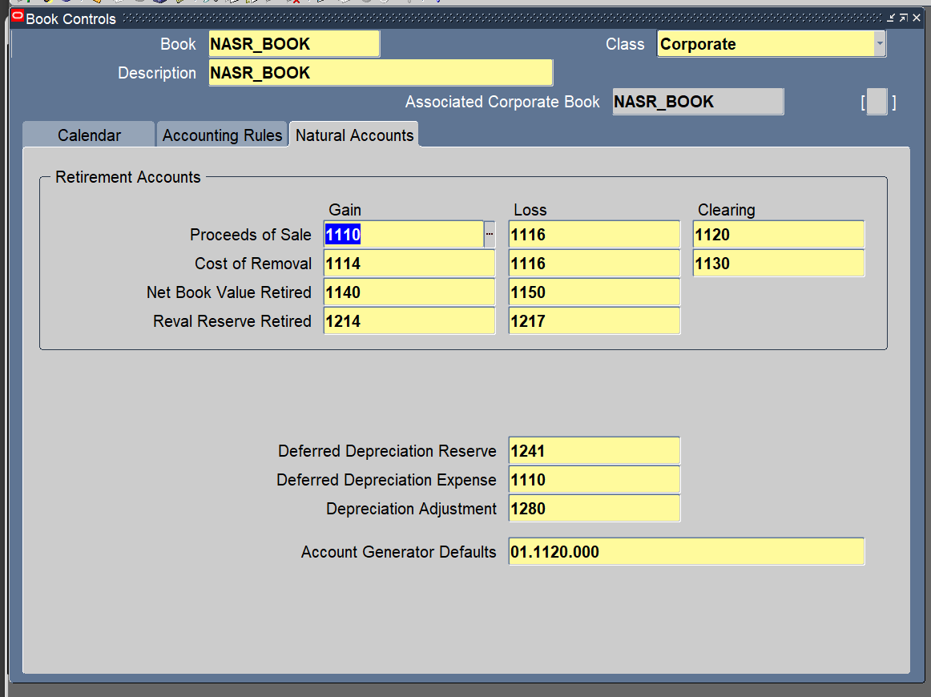
Setup Book Control

Slide 22
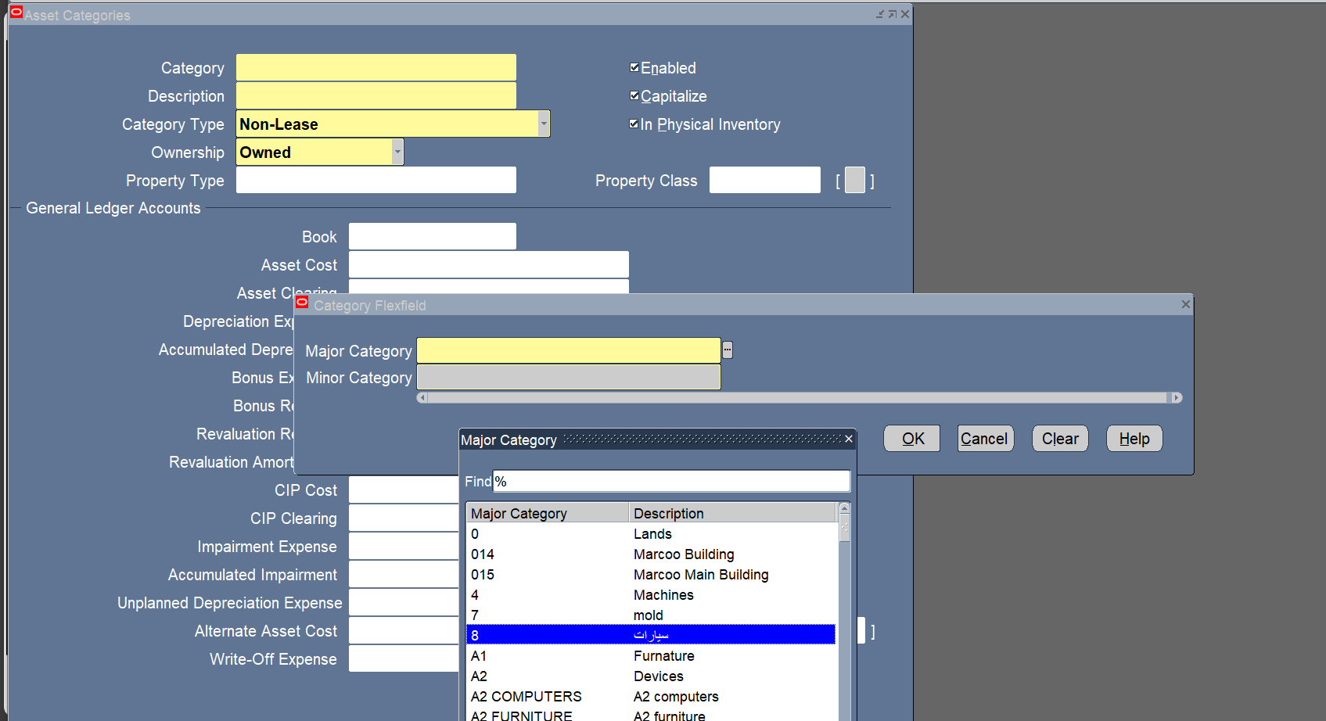
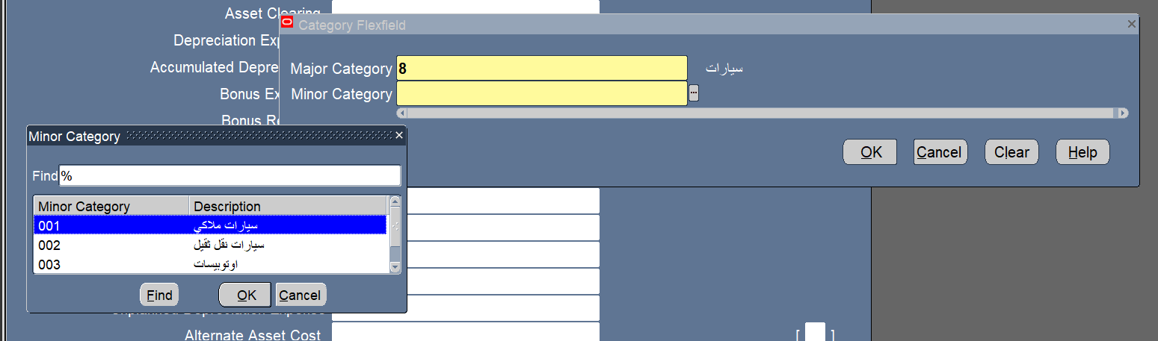
Setup Assets Categories

Slide 23
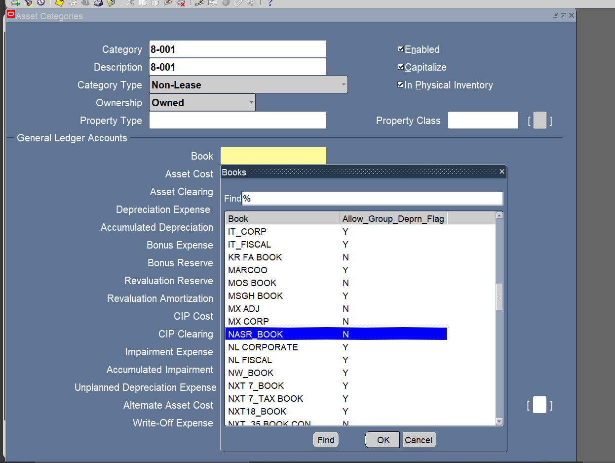
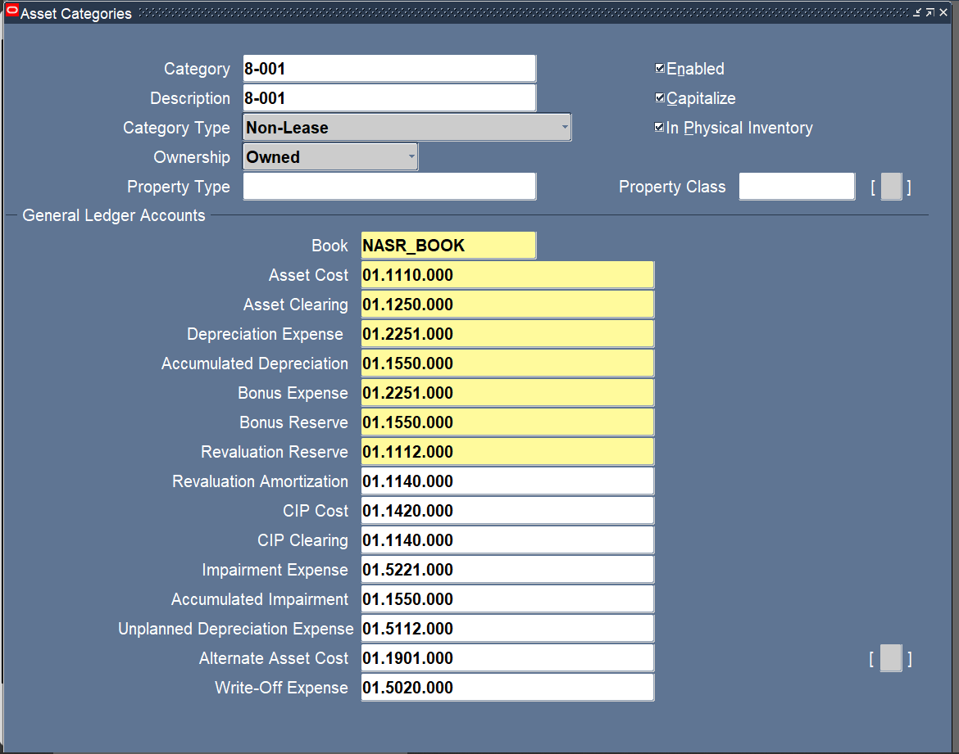

Slide 24
Name:Dina Mahmoud Ramadan
3-Manual Asset Adition.
4-Quick Addition.

Slide 25
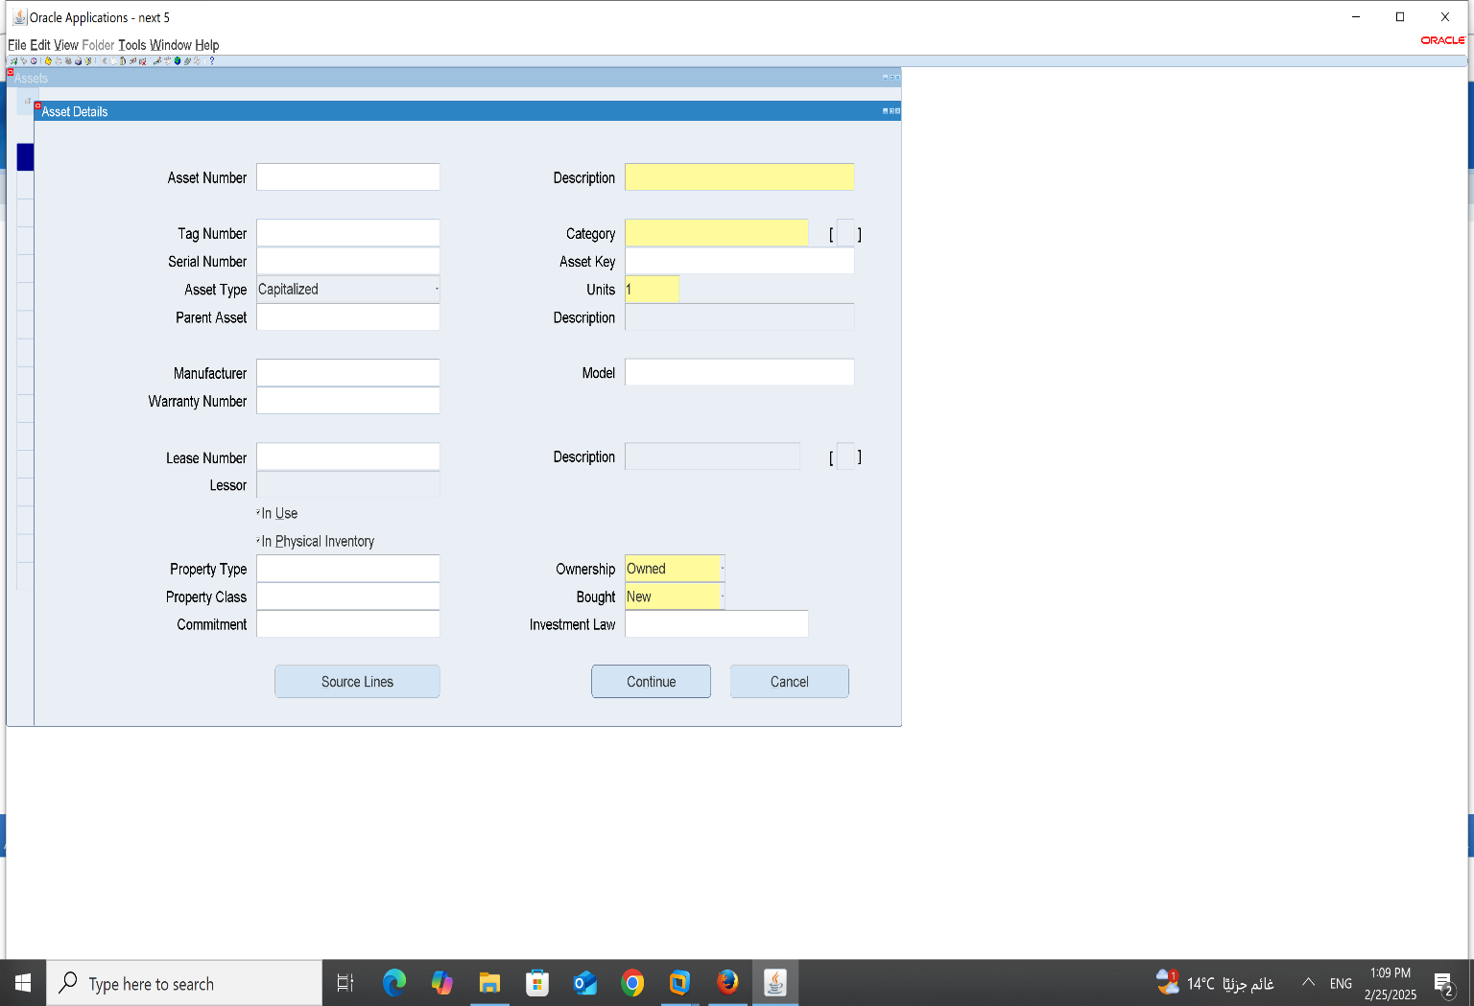
3-Manual Asset Adition:
Asset_Asset Workbench_Addition

Slide 26

Then We should fill the blancks 1-Description:

Slide 27
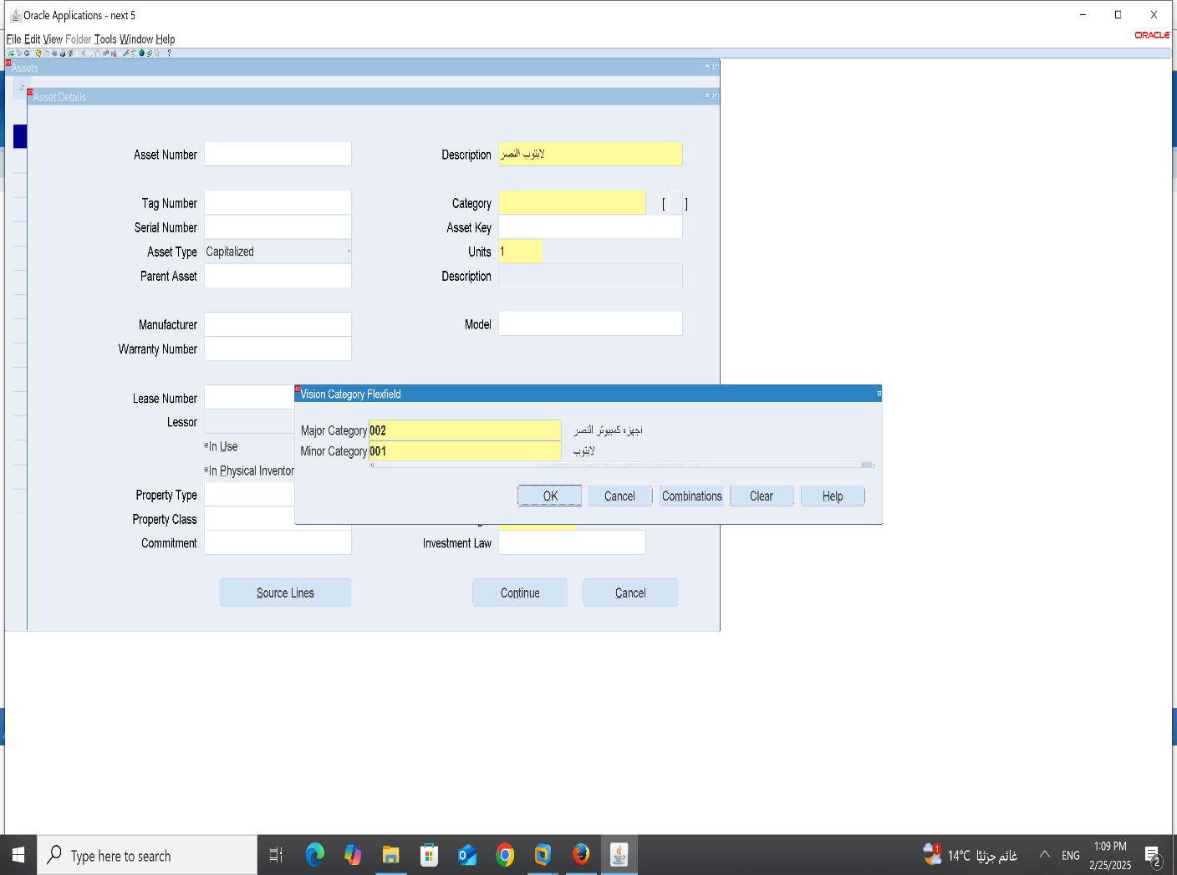
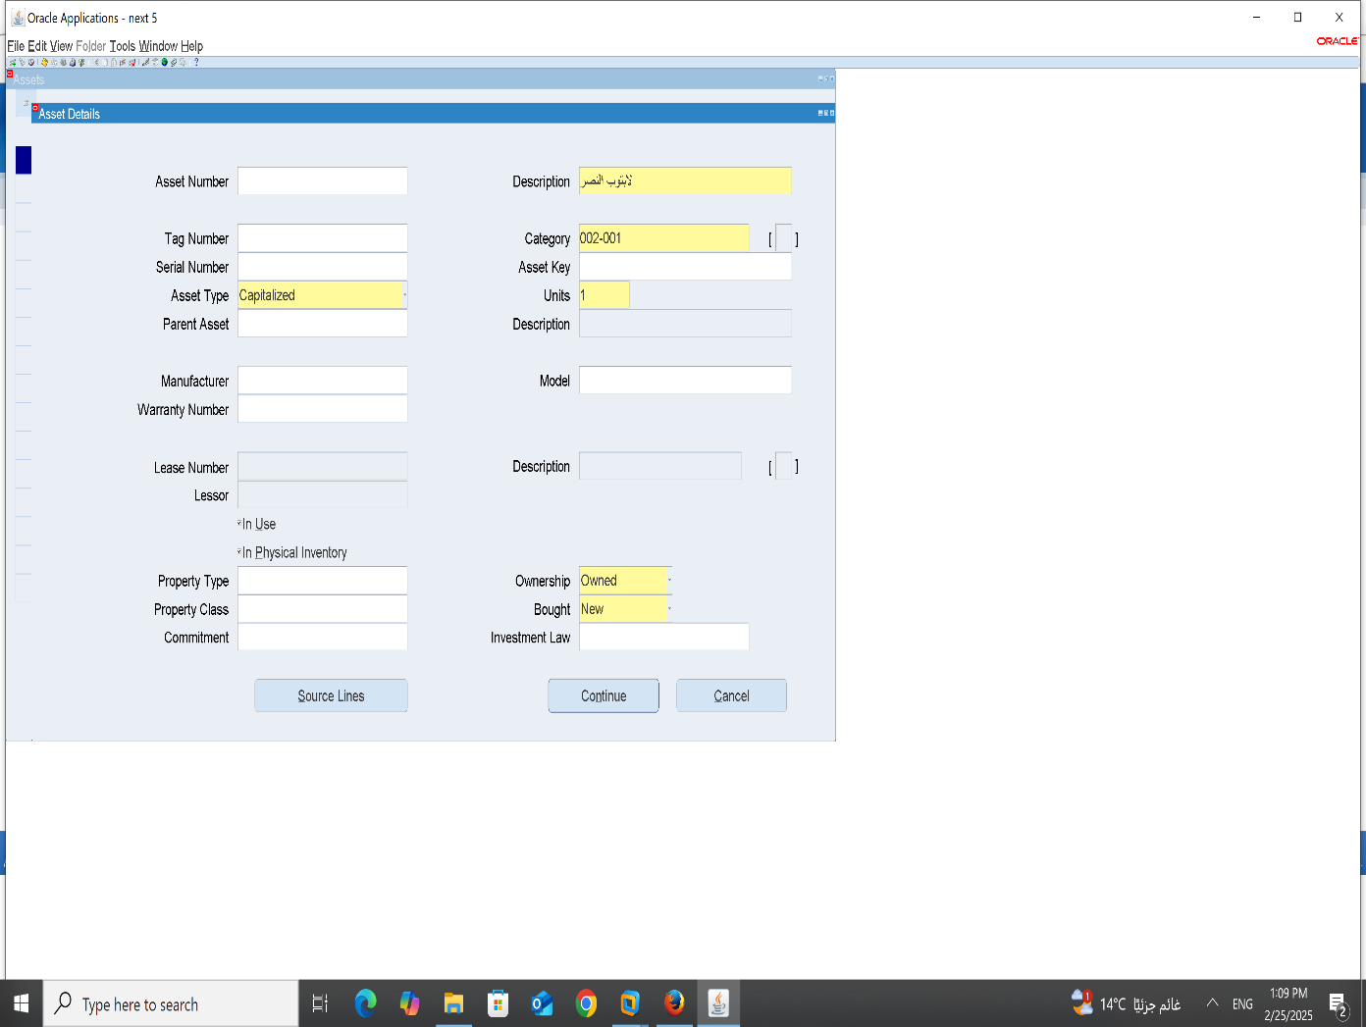
2-Category: A-major: B-minor:

Slide 28

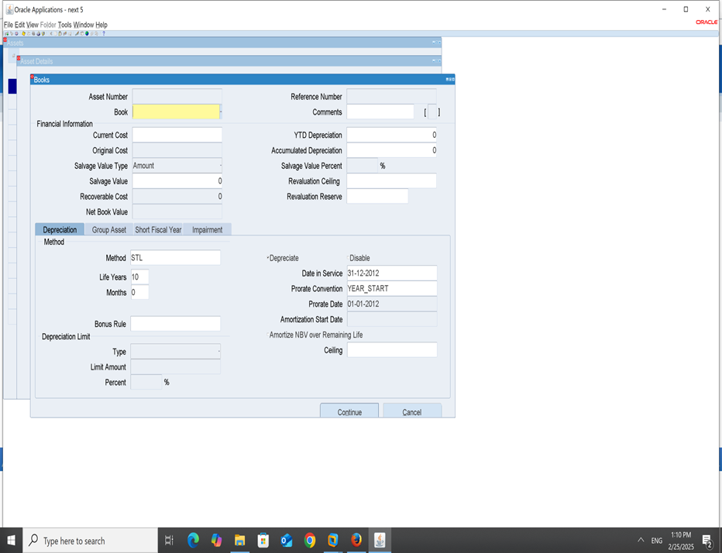
3-Asset key: 4-Units: 5-Then press countinue:

Slide 29
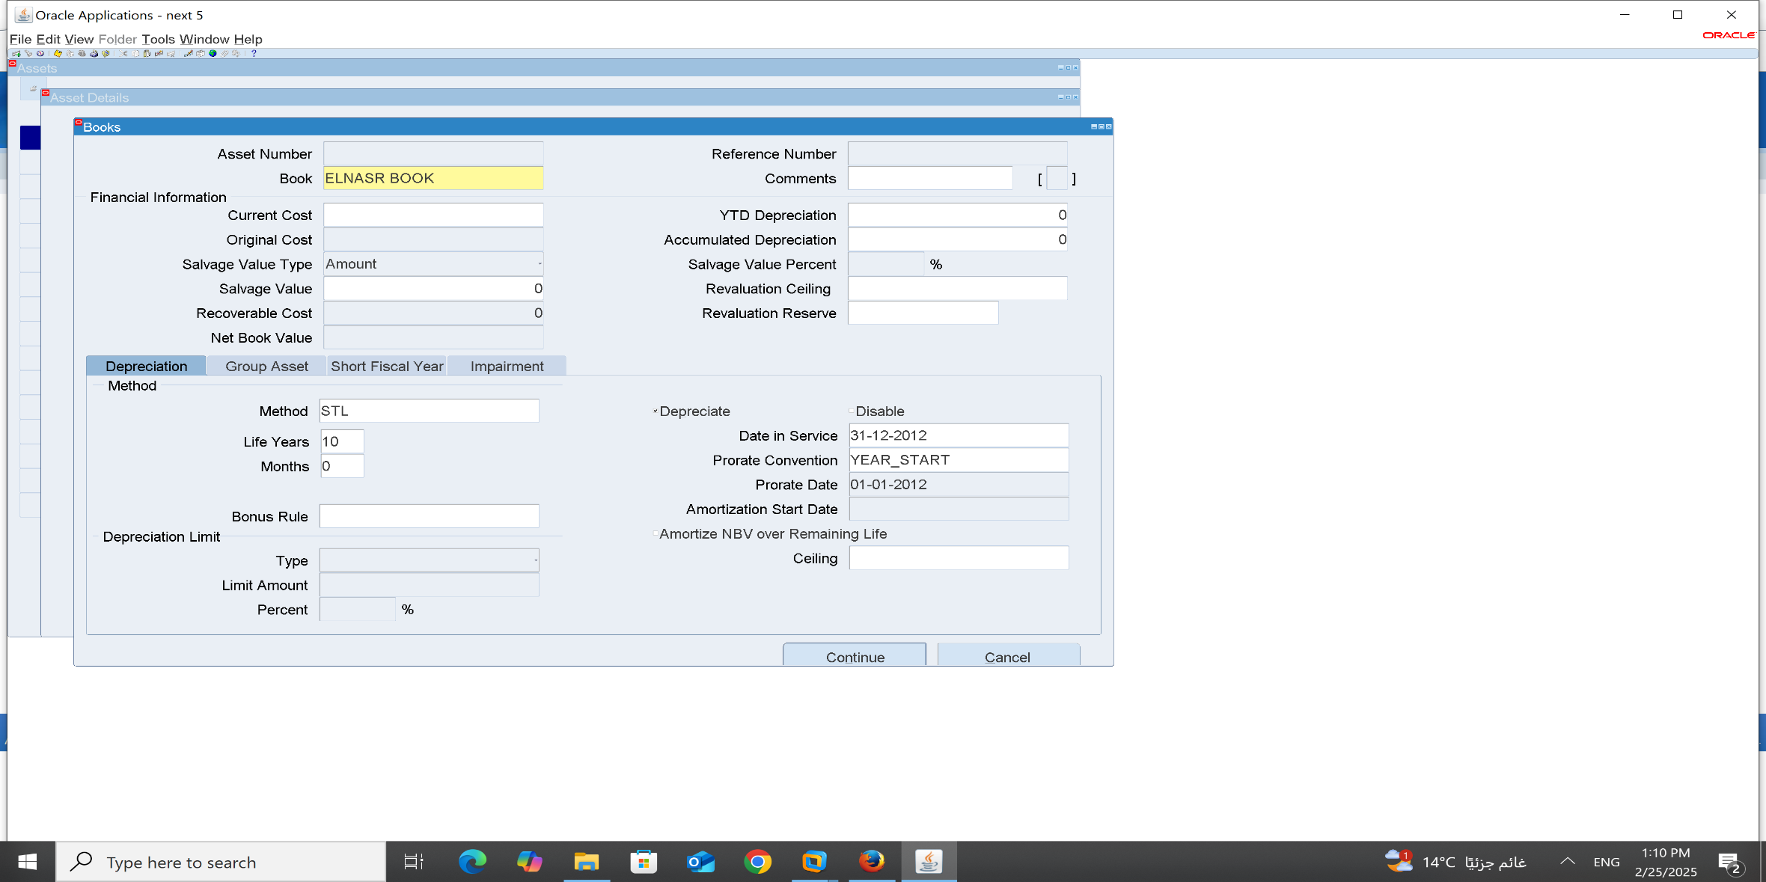
6-Book:

Slide 30
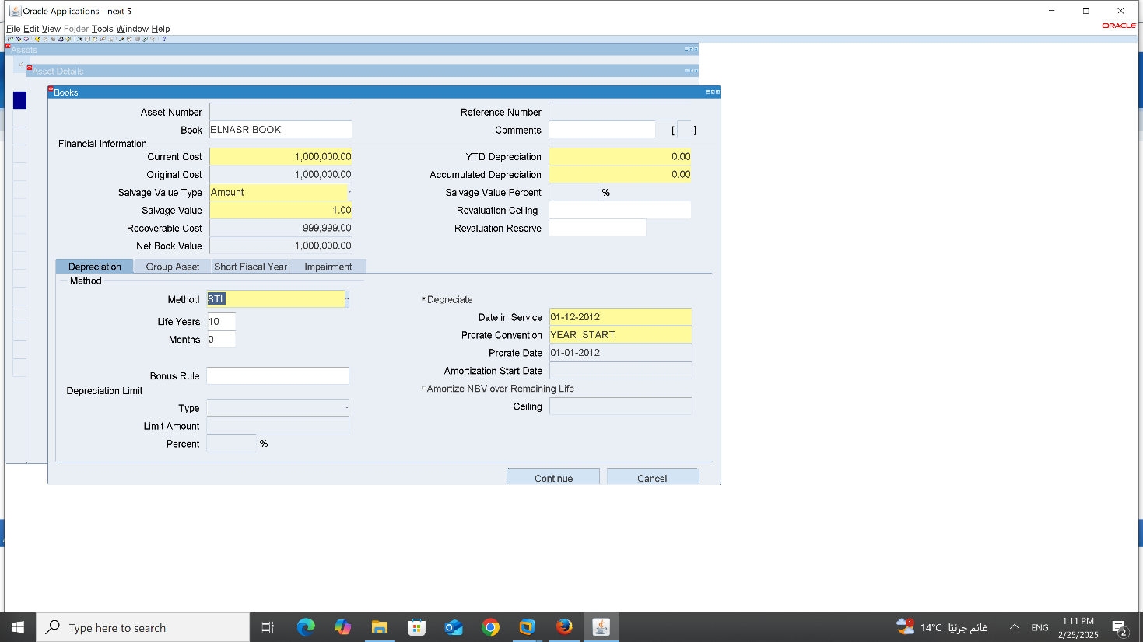
7-current Cost 8-Salvage value 9-Method –Life years-Months 10-Date in service-prorate convention-prorate date 11-press countinue

Slide 31
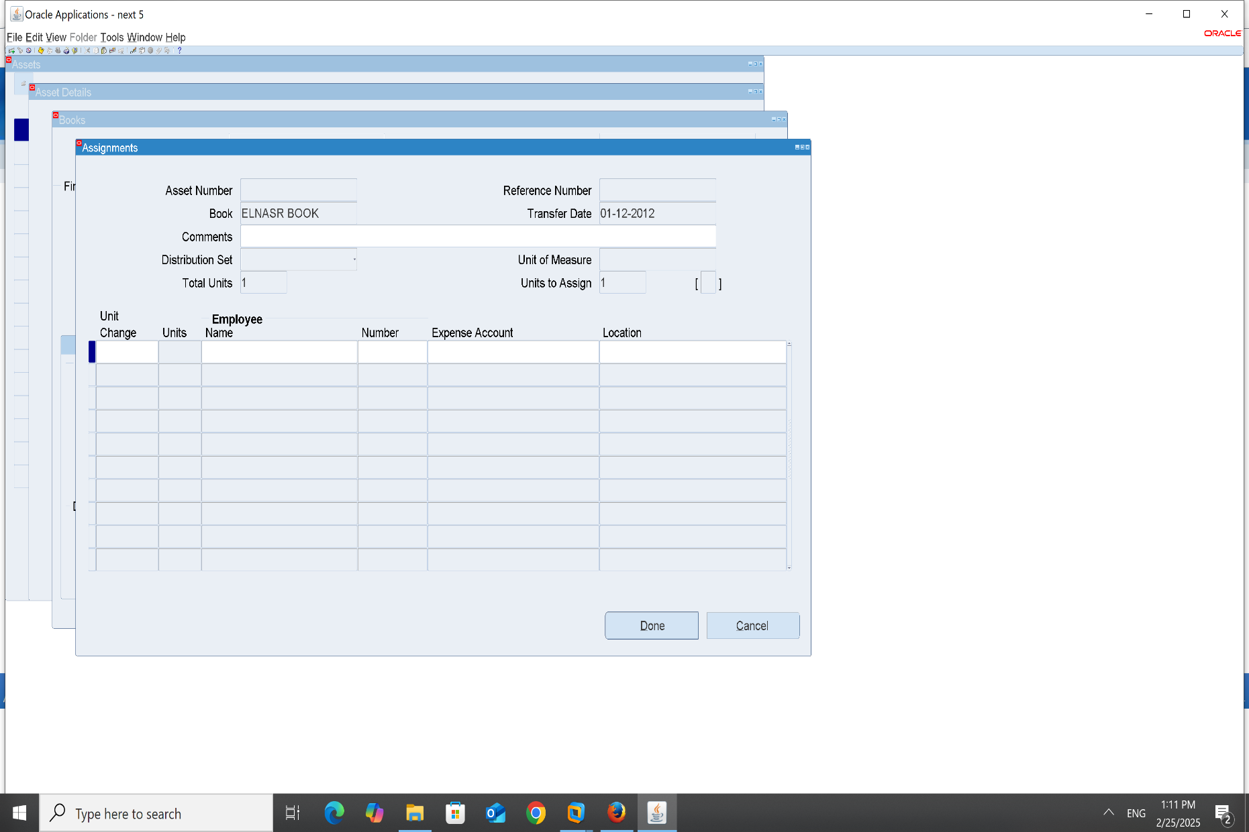
12-Book:

Slide 32
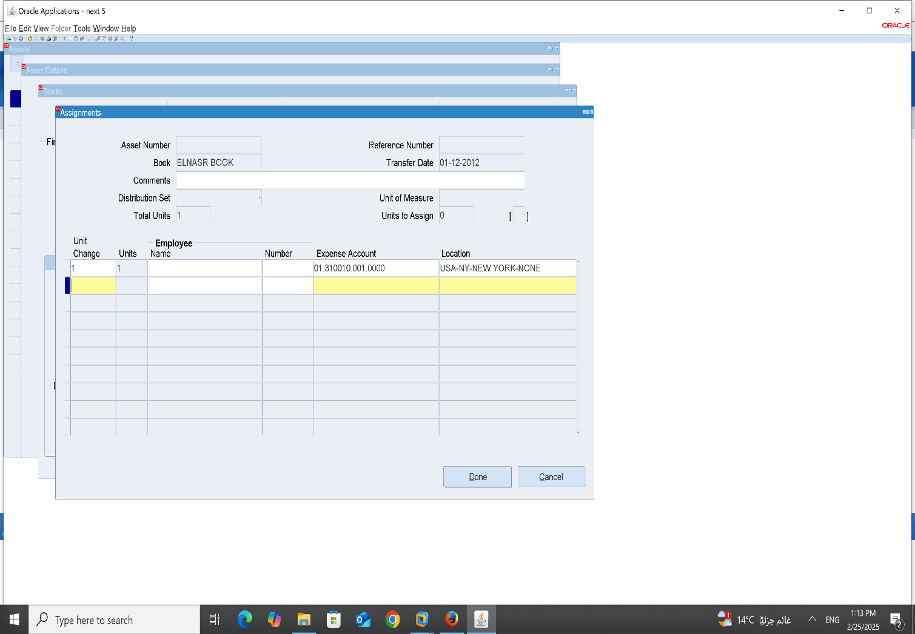
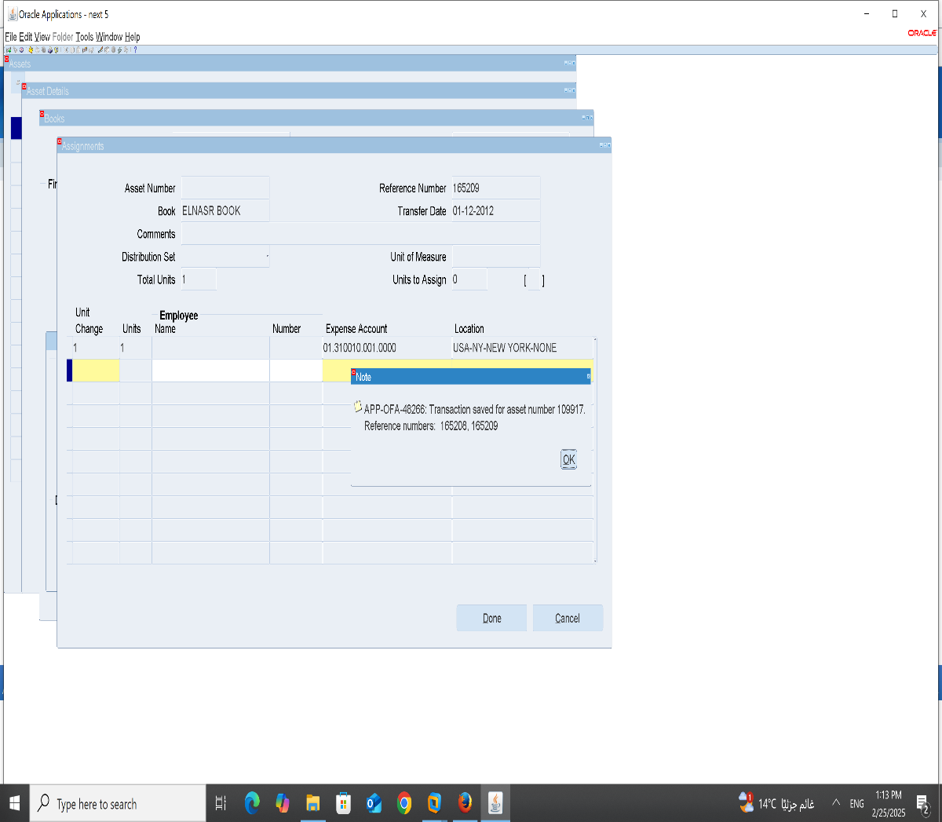
13- Unit Change –Expense Account-Location: 14-press Done

Slide 33
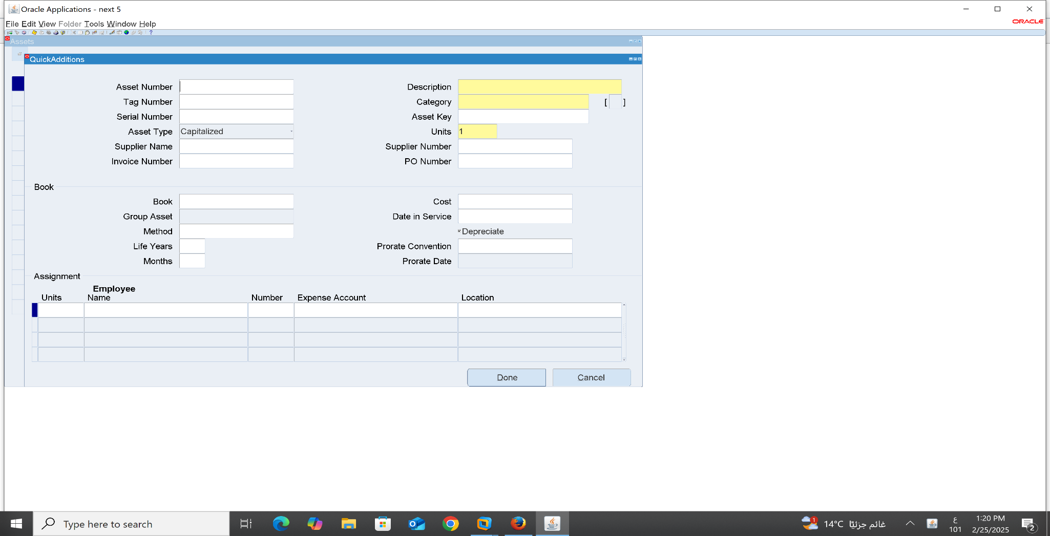
4-Quick Addition: Asset-Asset workbench-Quick Addition

Slide 34
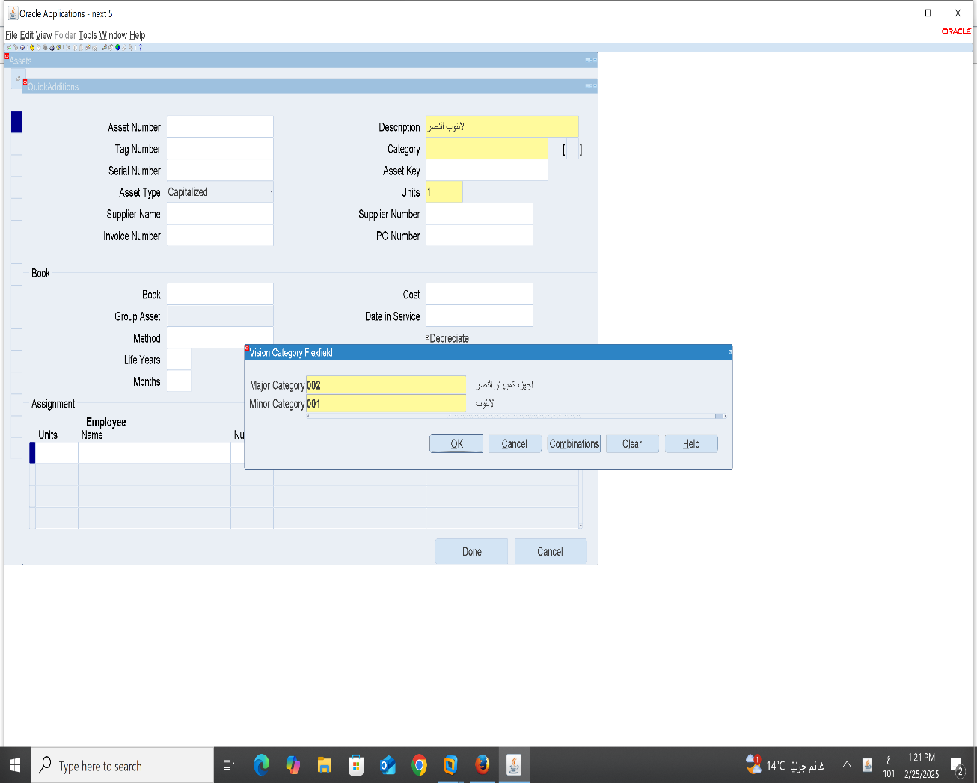
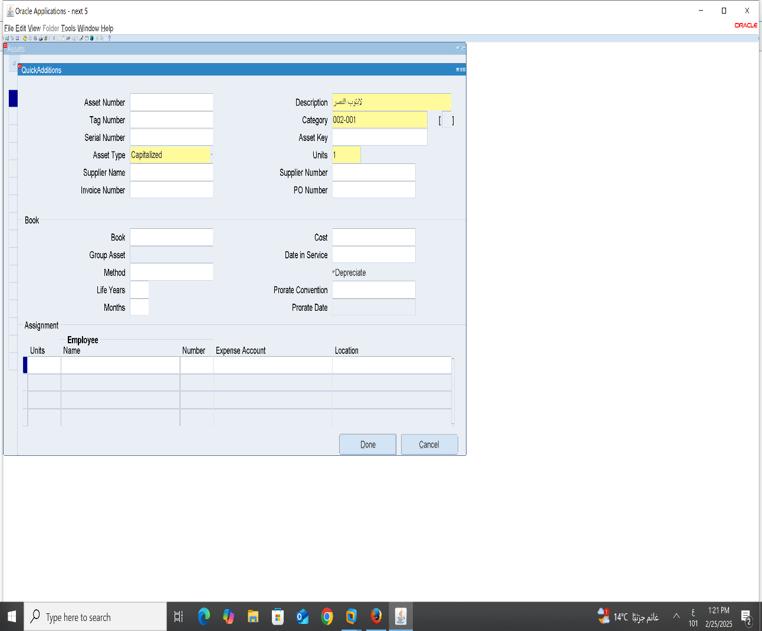
1-Description: 2-Category 3-Units

Slide 35
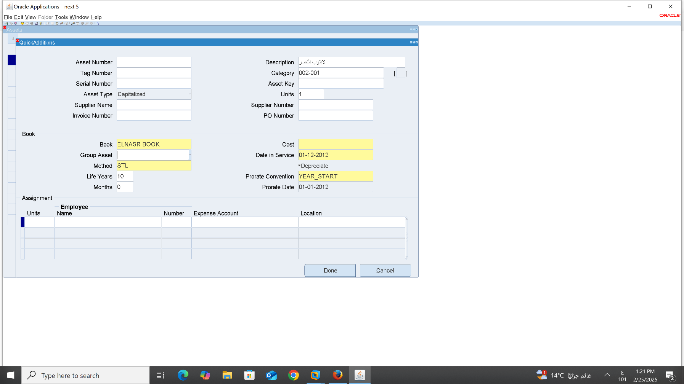
4-Book 5-Method-life yeard-Months 6- Cost-Date in service-prorate convention-prorate date

Slide 36
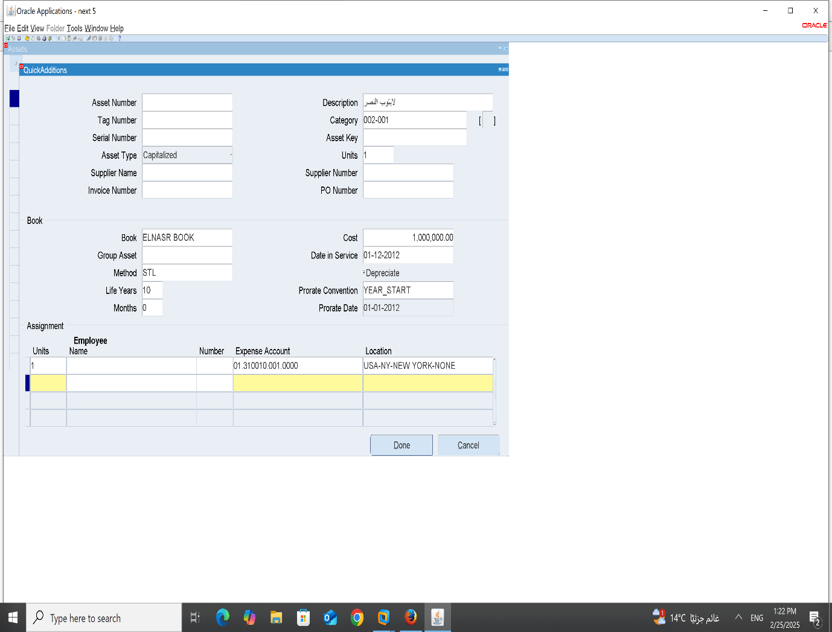

7-units change –Expense Account-Location: 8-Done

Slide 37
5 Mass Addition 6 CIP Assets Additions
Yahya Khaled

Slide 38

Mass Addition - Step 1

Slide 39

Mass Addition - Step 2

Slide 40

Mass Addition - Step 3

Slide 41

Mass Addition - Step 4

Slide 42

Mass Addition - Step 5

Slide 43

CIP Assets Addition - Step 1

Slide 44

CIP Assets Addition - Step 2

Slide 45

CIP Assets Addition - Step 3

Slide 46

CIP Assets Addition - Step 4

Slide 47
Name : Silvia Hany Abdelmasseh
7- Asset Mass Addition 8- Asset Mass Transactions

Slide 48

7- Asset Mass Addition from Asset – Asset Workbench – find the book you created and this screen will be shown

Slide 49

Manual edit from Machine to Vehicle. we can edit both category and description.

Slide 50

After editing

Slide 51


Editing number of units from 1 to 2

Slide 52

After editing we could add a second unit

Slide 53


Repeating the previous step by editing units and putting -1

Slide 54

Changing the cost of the asset by changing it from current cost

Slide 55

Editing location

Slide 56

After changing unit number 2

Slide 57

8- Asset Mass Transaction from Mass Transactions – Reclassifications

Slide 58

After editing

Slide 59
Name:Yousef Mosad
9- Run Depreciations
10-Create Accounting And Transfer To General Ledger

Slide 60

9 Run Depreciations 1- Depreciations 2- Run Depreciations

Slide 61


3-Book 4-Period

Slide 62

5 Run Request

Slide 63

10-Create Accounting And Transfer To General Ledger
1-Create Accounting

Slide 64

2-Name = Create Accounting - Assets

Slide 65

3-Book Type Code =Al nasr 4- repot= summary 5-ok

Slide 66

6- Submit

Slide 67

7-Run Request

Slide 68
End of Fixed Assets Module
Thank you

